Slide 1

Voice of Customers
Sentiment Analysis using NLP

Slide 2
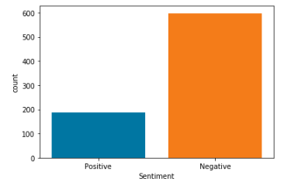
Use Case: Voice Of Customer
Part 1: Review comments from the customer facing application will be analyzed for polarity[Positive & Negative sentiments]
Part 2: Identify specific modules in the application that were reported with negative sentiment
Review Comments from Play Store has been extracted using Web Scrapping for Fly Delta and Air Canada Application
Total Number of Records Used – 785
INPUT
Part 1: Review Comments were extracted from Fly Delta and Air Canada applications using web scrapping in .csv format
Part 2: Predicted negative comments from the part 1 output
OUTPUT
Part 1: After processing the Review comments, sentiment polarity of the review comments are predicted
Part 2: Topic clusters from the review comments

Slide 3
Approach taken – Voice of customer
Data Extraction
Text Pre-Processing
Model Building
Model Evaluation
Sentiment Prediction for Polarity
Part – 1 – Sentiment Analysis
Negative review comments
Output of Part 1
Text Pre-Processing
Model building
**Model Evaluation
Categorization of modules from Negative Review comments
Part – 2 – Topic Modelling
**Model evaluation was measured only for Gensim implemented LDA and manually verified for the rest approaches

Slide 4
Sentiment Analysis – Detailed Approach
Data Extraction & Processing
Extracting Review Comments from Customer facing application using Web Scrapping/Direct API calls
Text Pre-processing
Removal of punctuations, digits and extra spaces
Modelling
Logistic Regression
Random Forest
XG Boost
Naïve Bias
Bi-Directional LSTM
Model Evaluation
Accuracy
Confusion Matrix
Classification Report
F1 Score
AUC Curve
Sentiment Prediction
Predicting Sentiment for the newer reviews and validating
Removal of unwanted codes(ASCII, UTF)
Feature creation
Text Cleansing & Processing
Counter Vectorization(ML)
TF-IDF(ML)
Tokenization(DL)
Lemmatization
Removal of stop words
N-grams for feature creation
Manual labelling of polarity to segregate positive and negative comments
Length normalization(DL)
Model Selection from the best performing models
Python and supporting libraries used
Python Data frames
Selenium
Sci-kit Learn
Pandas
Numpy
Matplotlib
NLTK
Keras
Seaborn
IMB learn
Sci-kit Learn
Keras
XGBoost
JobLib
Pickle
Gensim(DL)

Slide 5

Categorization – Topic Modelling

Slide 6
Topic Modelling – Detailed Approach
Work in progress
Output of Part-1
Output from Sentiment Analysis will be input for Topic Modelling
Text Pre-processing
Text Cleansing & Processing
Model building
Topic Modelling using LDA
Sentiment with Negative values are taken
NMF (Non-negative Matrix Factorization)
Categorization
Categorization of Data using various Topics
Model Evaluation & Validation
Removal of punctuations, digits and extra spaces
Feature creation
N-grams for feature creation
Counter Vectorization(ML)
TF-IDF(ML)
Removal of unwanted codes(ASCII, UTF)
Removal of stop words
Lemmatization
Length normalization(DL)
Model evaluation was measured only for Gensim implemented LDA and manually verified for the rest approaches
LDA with Gensim
CorEx(To be implemented)
Python and supporting libraries used
Python Data frames
Sci-kit Learn
Pandas
Numpy
Matplotlib
NLTK
Keras
Seaborn
IMB learn
Sci-kit Learn
JobLib
Pickle
Gensim

Slide 7
Recommendations – Best practices for Voice of customer
Pre-requisites
Model Selection
Training data set should be close to the actual possible reviews that would be used for prediction on theme
Good spread ratio between positive and negative comments to be used for training data set
Number of review comments to be used for training data set should be sufficient to produce better results – more the data set better the results
Criteria for selecting models for Sentiment analysis:
Quality of model F1 and AUC score should be high, false positives should be less as the intention is to not skip any negative comments in the reviews
Sentiment analysis model selection:
Naïve Bayes
Predicts a smaller number of False Positives when compared to other models
Cross validation, F1 and AUC scores are better
Bi-directional LSTM
Data propagation flow is bi-directional – past to future and future to past – learning of text context is better
Accuracy and AUC Score is better
Prevents over-fitting
II. Criteria for Topic Modelling selection[Work in progress]:
Keywords identified in the individual topic should be contextually clustered, Coherent score should be evaluated
Decision on choosing better model is in progress
Key pointers
If the data set is imbalanced – F1 score should be given more precedence
If the data set is balance - Accuracy should be given precedence
Lemmatization and stemming of data can provide better topic clusters
Higher K-fold cross validation score, better the model
Topic modelling works better for certain use case with tri-Grams

Slide 8
Conclusion
Sentiment Analysis using Machine learning and Deep learning approaches are completed and Best Models have been identified
Topic Modelling using the output of Sentiment Analysis is in progress.
Risks :
When the data imbalance, the accuracy of the Sentiment analysis model will be affected
Data used for Topic Modelling is small, hence the words are presented in multiple topics. Increasing the data size may reduce the repetition of words in multiple topics Topic Modelling using the output of Sentiment Analysis is in progress.

Slide 9

Thank you

Slide 10
Machine Learning Approaches & Results

Slide 11
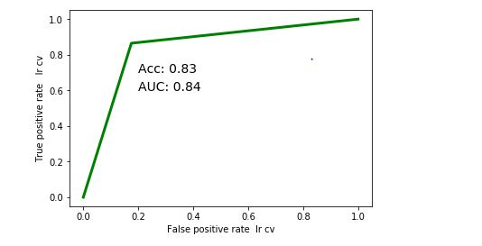
Logistic Regression – Count Vectorizer
Logistic Regression is a Predictive Analysis that can be used when the target variable is Binary.
The CountVectorizer provides a simple way to both tokenize a collection of text documents and build a vocabulary of known words, but also to encode new documents using that vocabulary.
Accuracy is 83.44%
Classification Report | Precision | Recall | F1 – Score | Support
0 | 0.95 | 0.82 | 0.88 | 120
1 | 0.60 | 0.86 | 0.71 | 37
Accuracy |  |  | 0.83 | 157
Macro Avg | 0.78 | 0.84 | 0.80 | 157
Weighted Avg | 0.87 | 0.83 | 0.84 | 157
AUC | 0.844932432432432

Slide 12
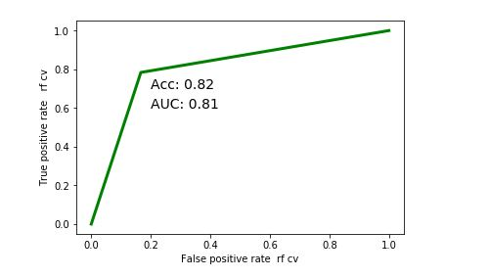
Random Forest – Count Vectorizer
Random forest consists of a large number of individual decision trees that operate as an ensemble. Each individual tree in the random forest spits out a class prediction and the class with the most votes becomes our model’s prediction
The CountVectorizer provides a simple way to both tokenize a collection of text documents and build a vocabulary of known words, but also to encode new documents using that vocabulary.
Accuracy is 82.17%
Classification Report | Precision | Recall | F1 – Score | Support
0 | 0.93 | 0.83 | 0.88 | 120
1 | 0.59 | 0.78 | 0.67 | 37
Accuracy |  |  | 0.82 | 157
Macro Avg | 0.76 | 0.81 | 0.78 | 157
Weighted Avg | 0.85 | 0.82 | 0.83 | 157
AUC | 0.808558558558558

Slide 13
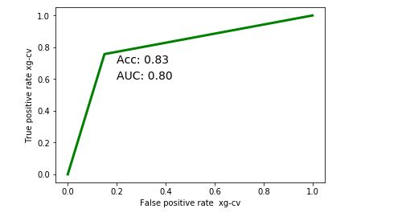
XG Boost– Count Vectorizer
XGBoost is an optimized gradient boosting algorithm through parallel processing, handling missing values and and regularization to avoid overfitting and bias
The CountVectorizer provides a simple way to both tokenize a collection of text documents and build a vocabulary of known words, but also to encode new documents using that vocabulary.
Accuracy is 82.8%
Classification Report | Precision | Recall | F1 – Score | Support
0 | 0.92 | 0.85 | 0.88 | 120
1 | 0.61 | 0.76 | 0.67 | 37
Accuracy |  |  | 0.83 | 157
Macro Avg | 0.76 | 0.80 | 0.78 | 157
Weighted Avg | 0.85 | 0.83 | 0.83 | 157
AUC | 0.8033783

Slide 14
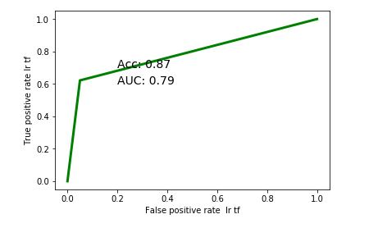
Logistic Regression – TFIDF Vectorizer
Logistic Regression is a Predictive Analysis that can be used when the target variable is Binary.
TfidfVectorizer - Transforms text to feature vectors that can be used as input to estimator
Accuracy is 87.26%
Classification Report | Precision | Recall | F1 – Score | Support
0 | 0.89 | 0.95 | 0.92 | 120
1 | 0.79 | 0.62 | 0.70 | 37
Accuracy |  |  | 0.87 | 157
Macro Avg | 0.84 | 0.79 | 0.81 | 157
Weighted Avg | 0.87 | 0.87 | 0.87 | 157
AUC | 0.78581081081081

Slide 15
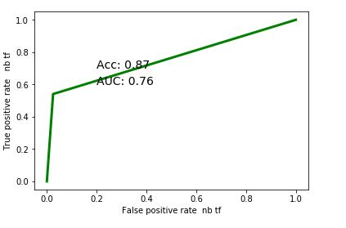
Naïve Bayes – TFIDF Vectorizer
Naive Bayes is a classification algorithm for binary (two-class) and multi-class classification problems. Instead of calculating the value for each attribute, it assumed to be conditionally independent given the target value.
TFIDF Vectorizer - Transforms text to feature vectors that can be used as input to estimator
Accuracy is 87.26%
Classification Report | Precision | Recall | F1 – Score | Support
0 | 0.87 | 0.97 | 0.92 | 120
1 | 0.87 | 0.54 | 0.67 | 37
Accuracy |  |  | 0.87 | 157
Macro Avg | 0.87 | 0.76 | 0.79 | 157
Weighted Avg | 0.87 | 0.87 | 0.86 | 157
AUC | 0.757770270

Slide 16
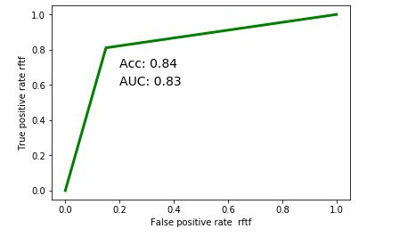
Random Forest – TFIDF Vectorizer
Random forest consists of a large number of individual decision trees that operate as an ensemble. Each individual tree in the random forest spits out a class prediction and the class with the most votes becomes our model’s prediction
TFIDF Vectorizer - Transforms text to feature vectors that can be used as input to estimator
Accuracy is 82.17%
Classification Report | Precision | Recall | F1 – Score | Support
0 | 0.94 | 0.85 | 0.89 | 120
1 | 0.62 | 0.81 | 0.71 | 37
Accuracy |  |  | 0.84 | 157
Macro Avg | 0.78 | 0.83 | 0.80 | 157
Weighted Avg | 0.86 | 0.84 | 0.85 | 157
AUC | 0.830405

Slide 17
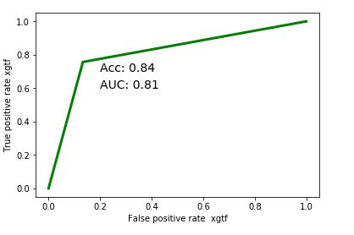
XG Boost– TFIDF Vectorizer
XGBoost is an optimized gradient boosting algorithm through parallel processing, handling missing values and and regularization to avoid overfitting and bias
TFIDF Vectorizer - Transforms text to feature vectors that can be used as input to estimator
Accuracy is 84.08%
Classification Report | Precision | Recall | F1 – Score | Support
0 | 0.92 | 0.87 | 0.89 | 120
1 | 0.61 | 0.76 | 0.69 | 37
Accuracy |  |  | 0.84 | 157
Macro Avg | 0.78 | 0.81 | 0.79 | 157
Weighted Avg | 0.85 | 0.84 | 0.85 | 157
AUC | 0.811711

Slide 18
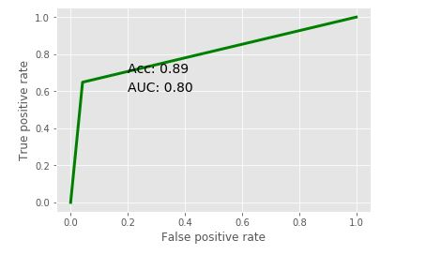
Bi Directional LSTM
Bidirectional LSTM means the Data propagates backward as well as forward in time. Feed the learning algorithm with the original data once from beginning to the end and once from end to beginning. Hence It learns faster than one-directional approach
Accuracy is 88.54%
Classification Report | Precision | Recall | F1 – Score | Support
0 | 0.90 | 0.96 | 0.93 | 120
1 | 0.83 | 0.65 | 0.73 | 37
Accuracy |  |  | 0.89 | 157
Macro Avg | 0.86 | 0.80 | 0.83 | 157
Weighted Avg | 0.88 | 0.89 | 0.88 | 157
AUC | 0.803490

